Slide 1
Cleaning the Galaxy
Trying to determine the error of the Hubble Space Telescope
Leslie Raganit

Slide 2
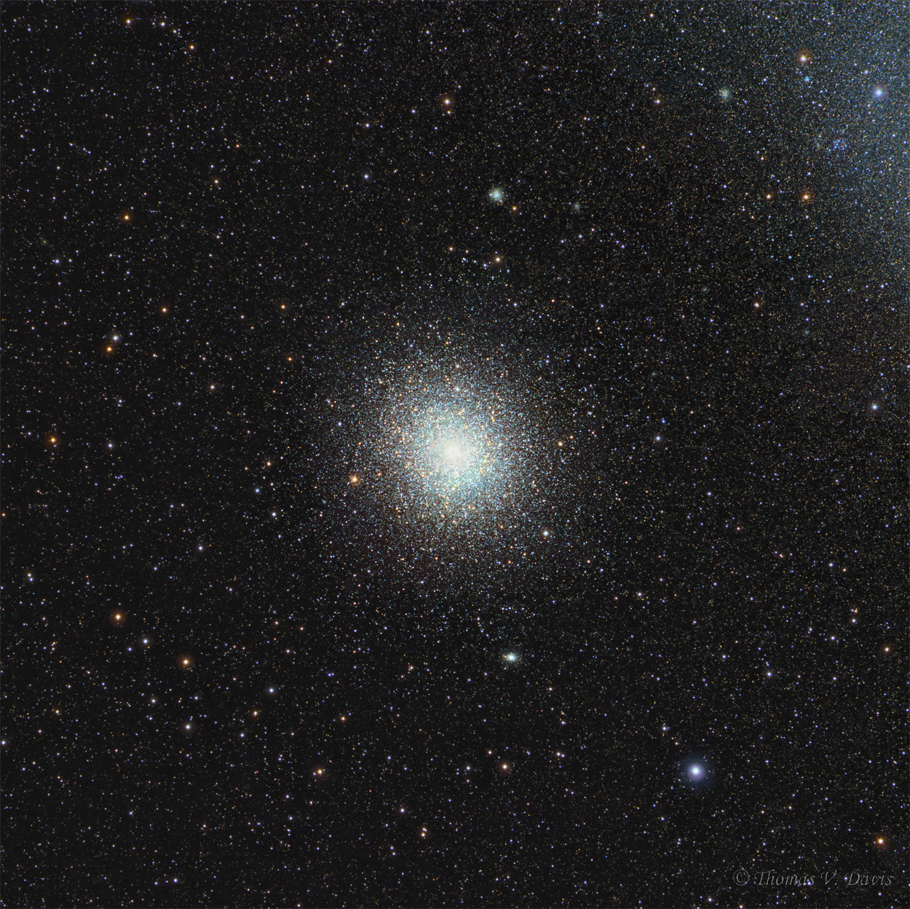
Introduction
Null Hypothesis: HST has no internal error
Alternative Hypothesis: HST has error

Slide 3
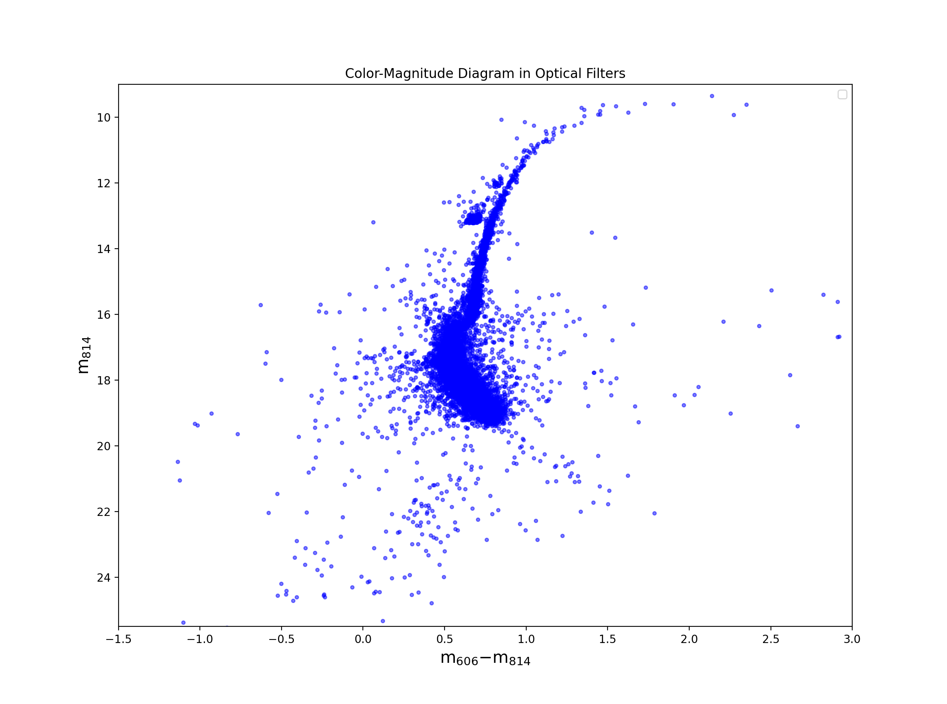
Crash landing on cmdS
EVERY STAR IS MAPPED ONTO CMDS
THE WIDTH OF THE MAIN SEQUENCE IS THE ERROR OF THE INSTRUMENT THAT TAKES THE DATA
WE’RE GOING TO REMOVE EXTERNAL ERROR

Slide 4
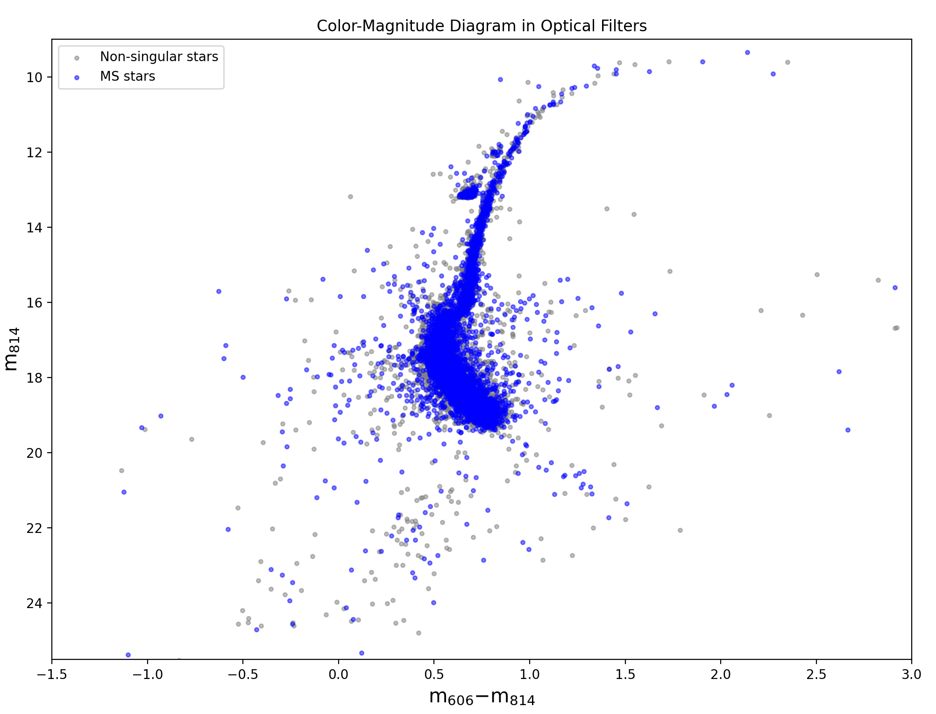
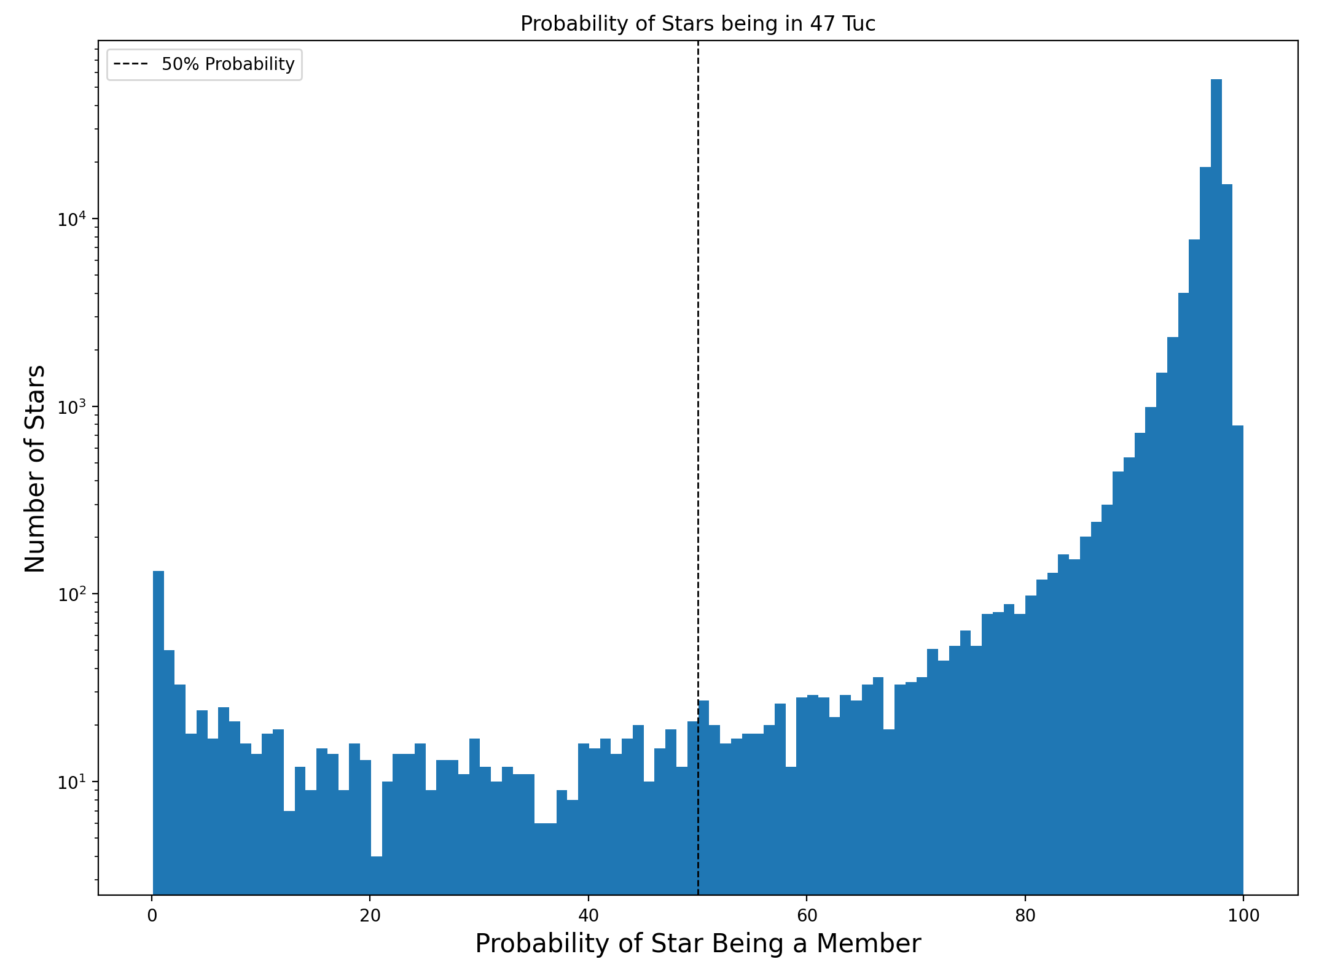
You can’t sit with us

Slide 5
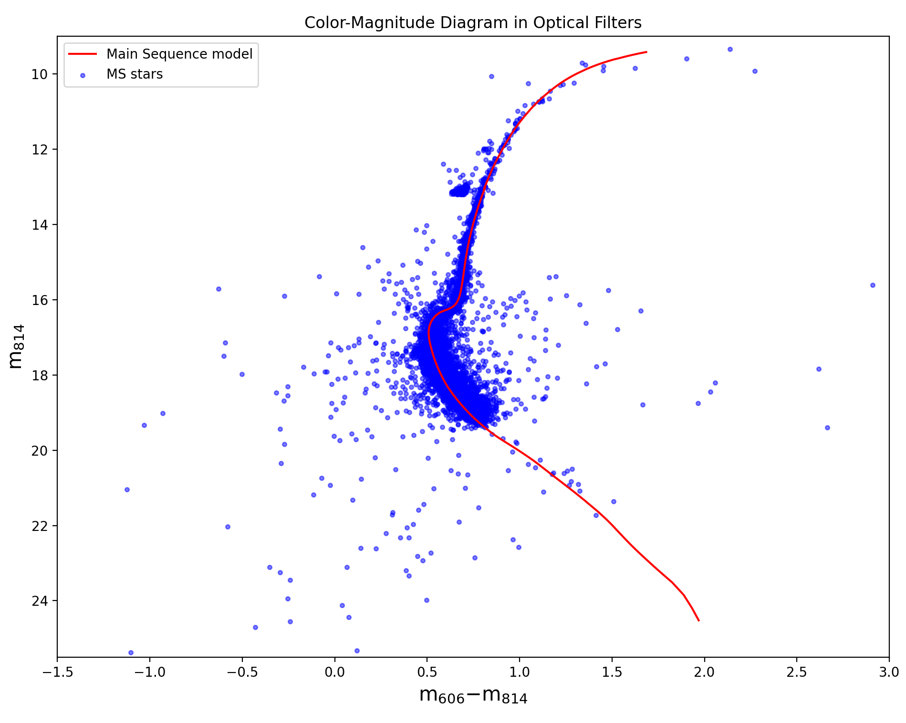
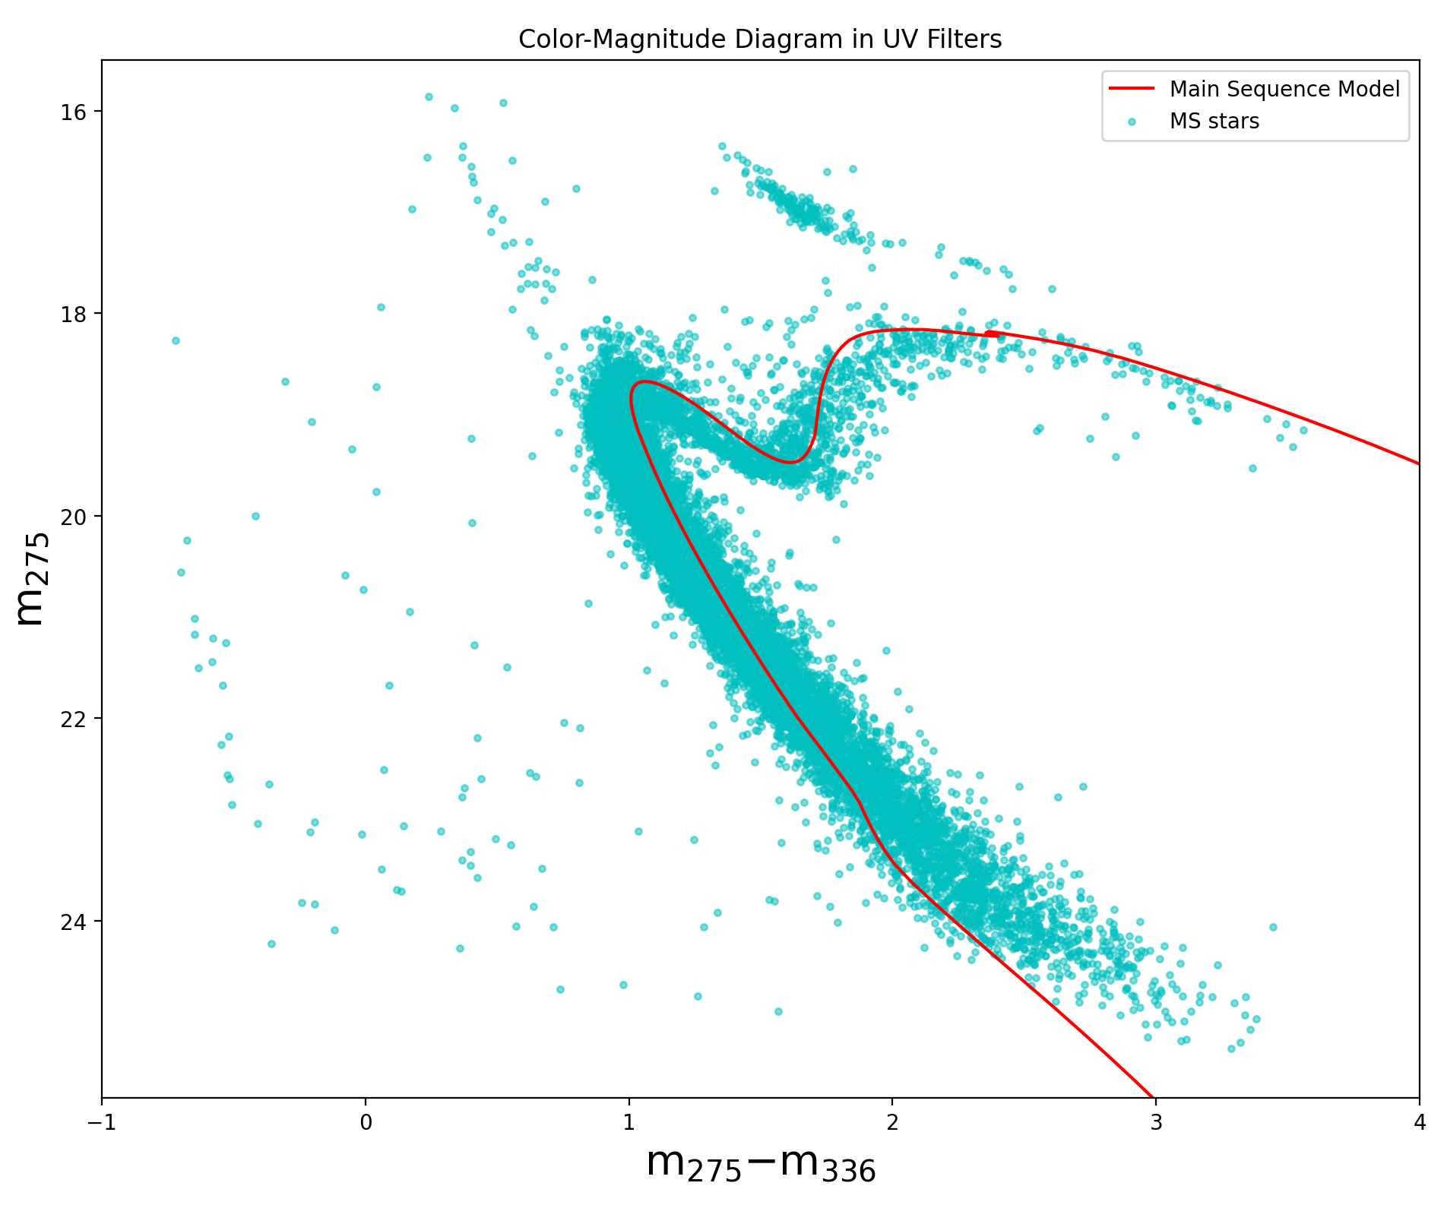
Follow the red brick road

Slide 6
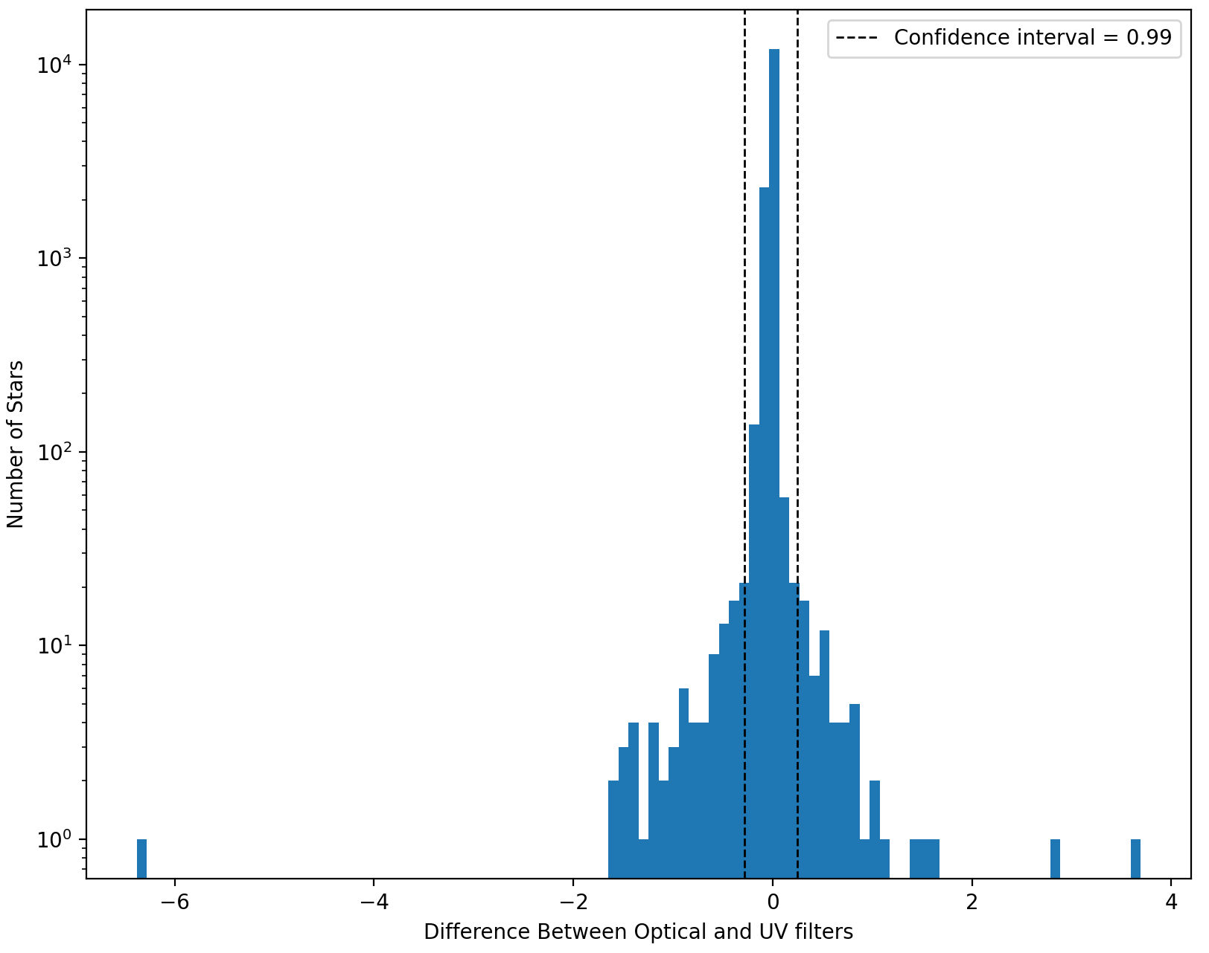
Prepare for trouble
Measured the differences of the the two filters
Stars that had a large delta were considered to be part of a non-singular light source

Slide 7
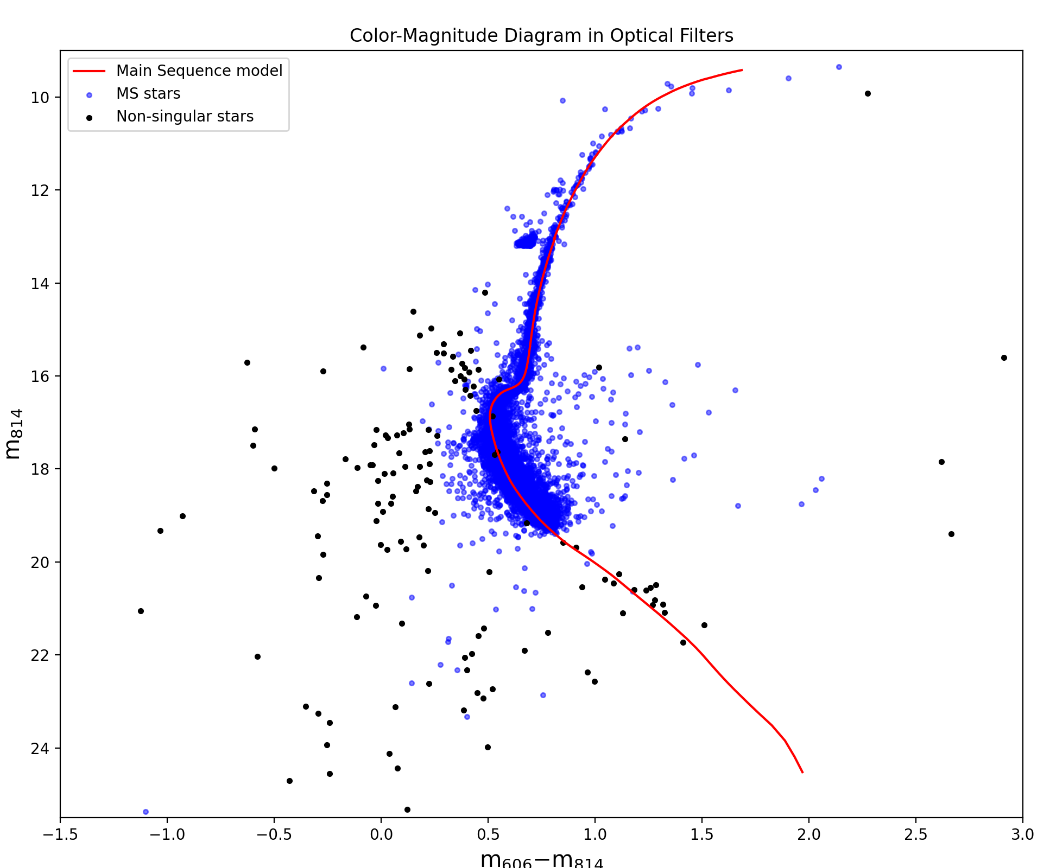
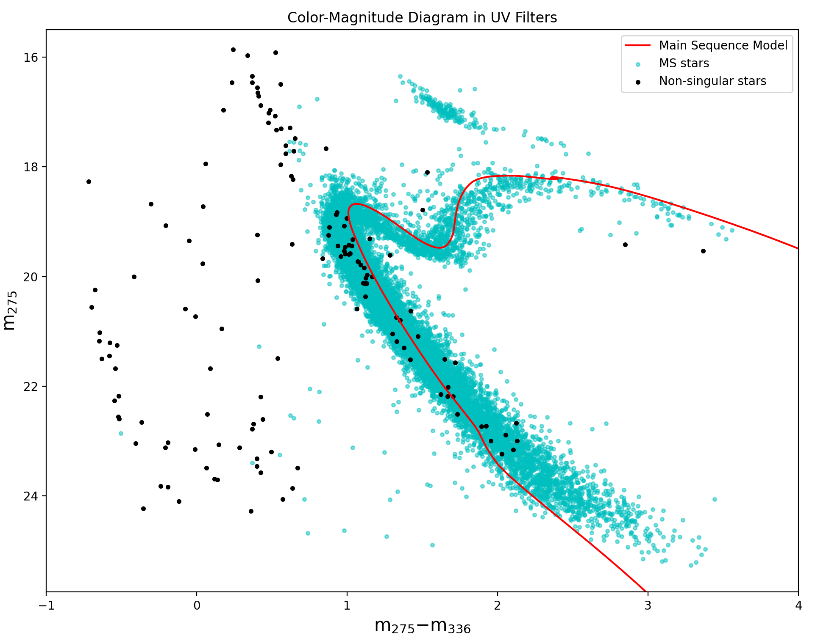
And make it double

Slide 8
Drumroll please!

Slide 9
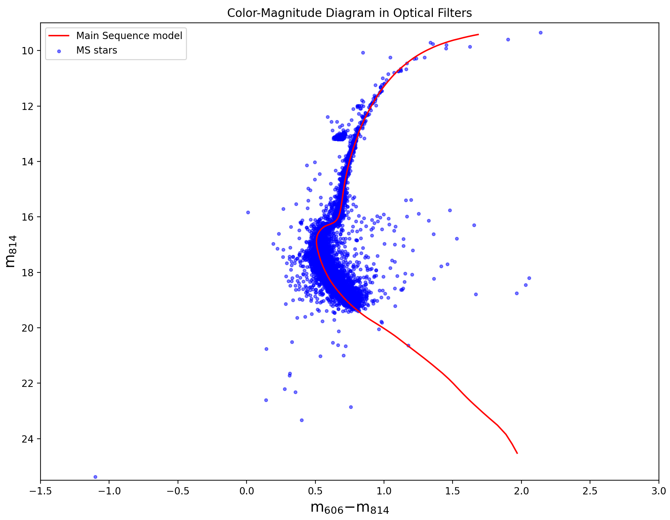

Slide 10
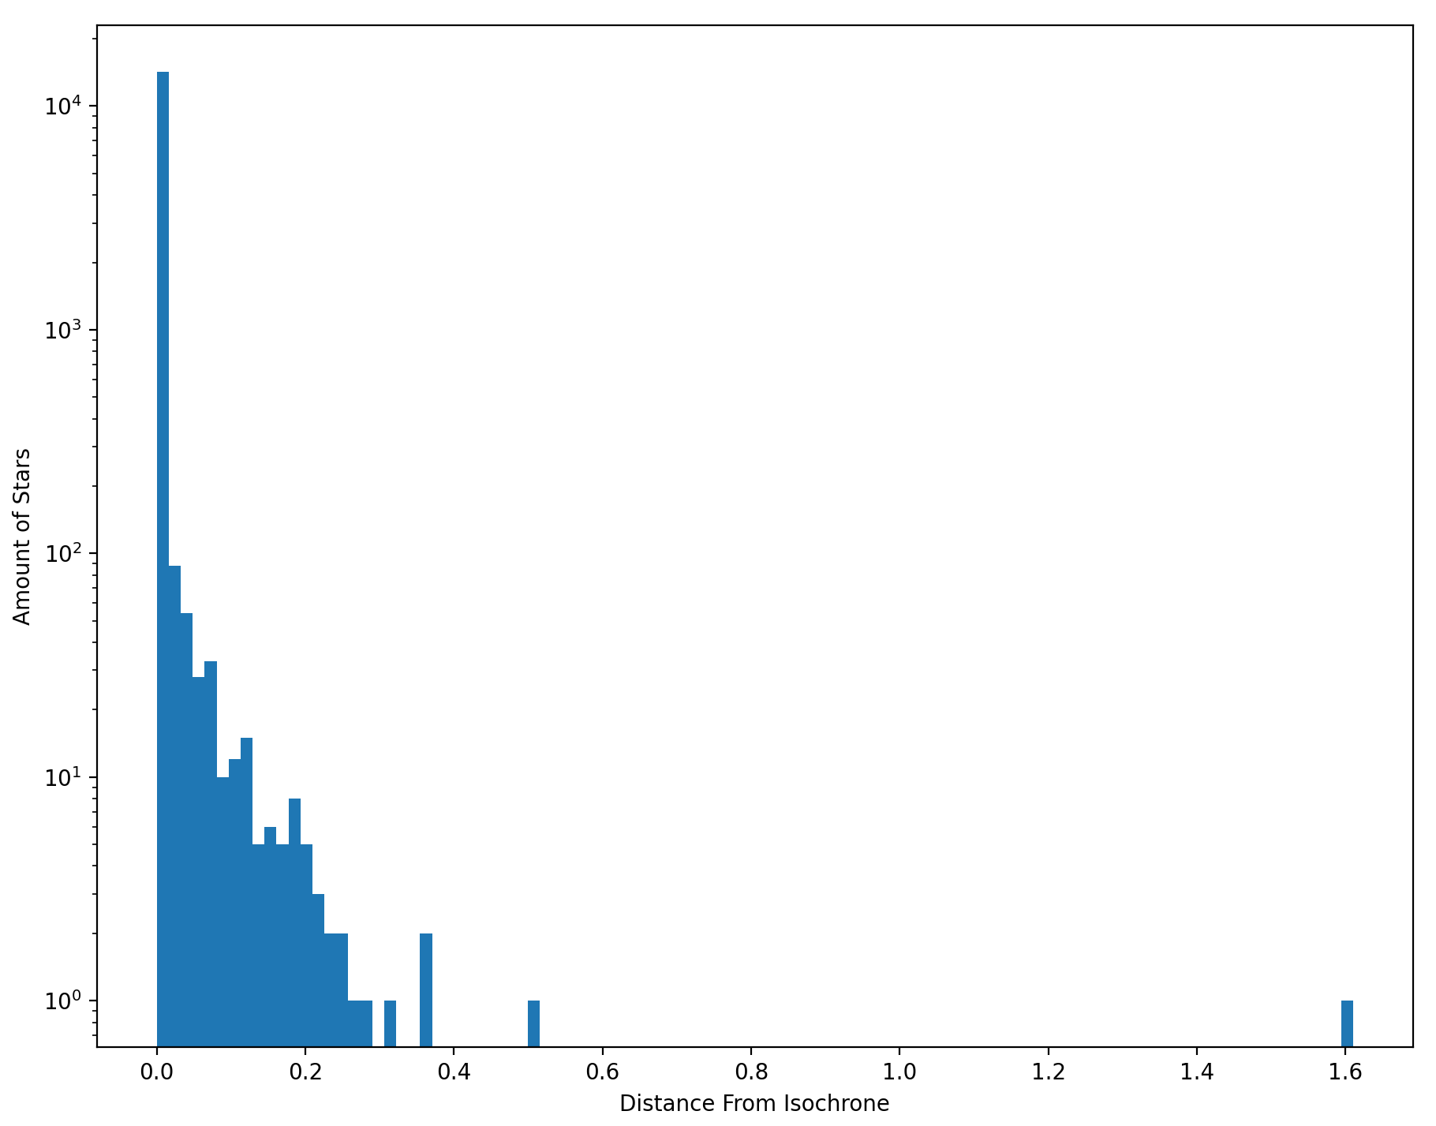
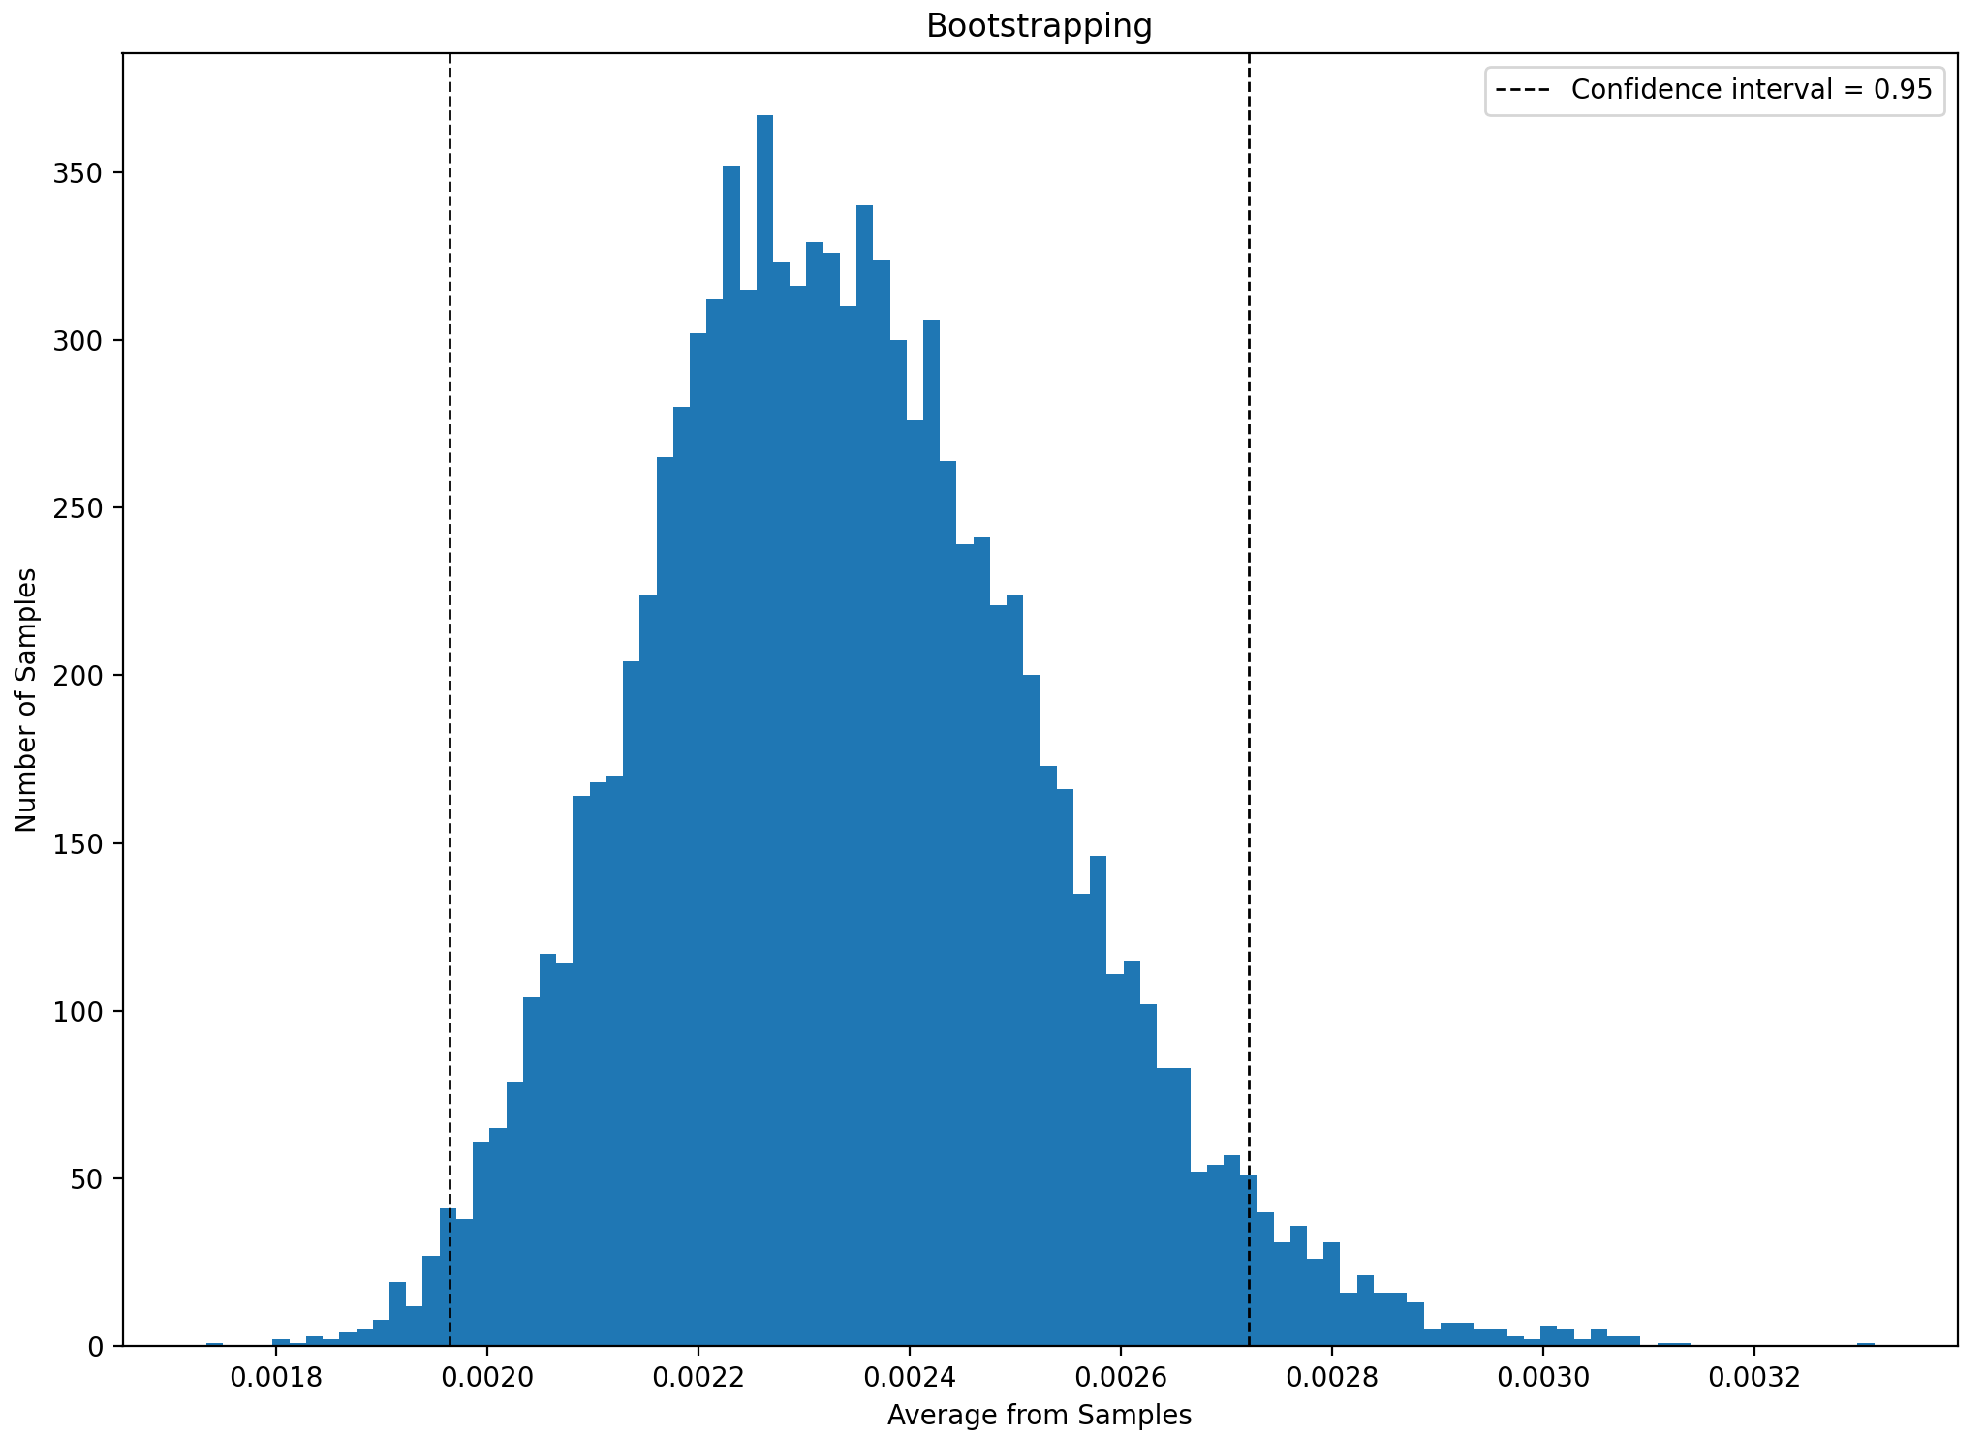
There’s a snake in my boot

